Slide 1
VLP-16
Webserver Interface Screens

Slide 2
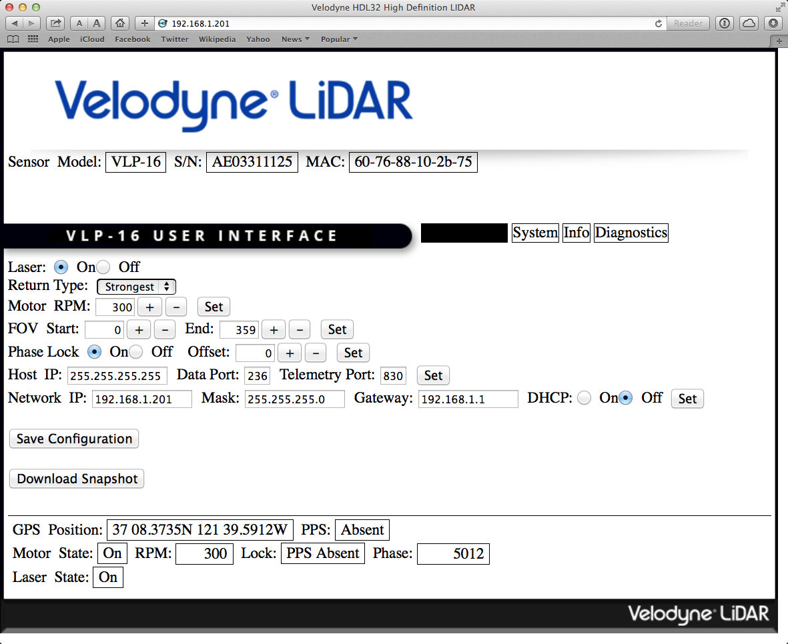
Configuration Page

Slide 3
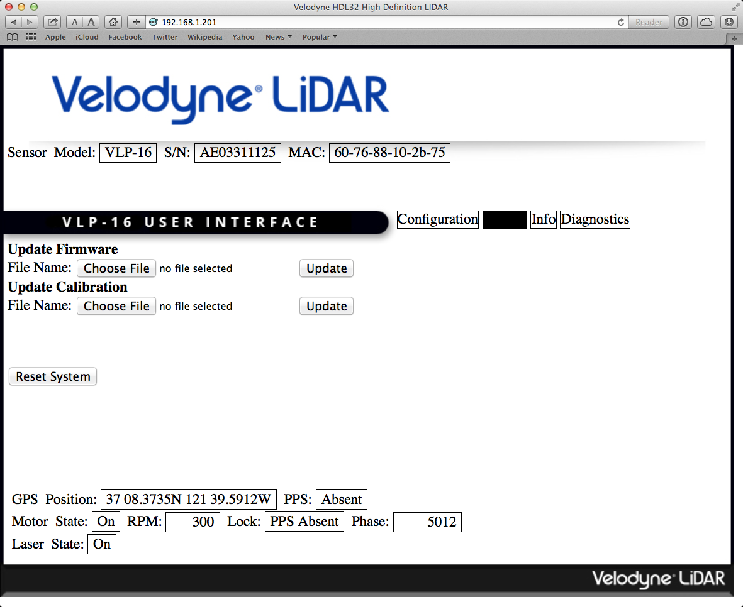
System Page

Slide 4
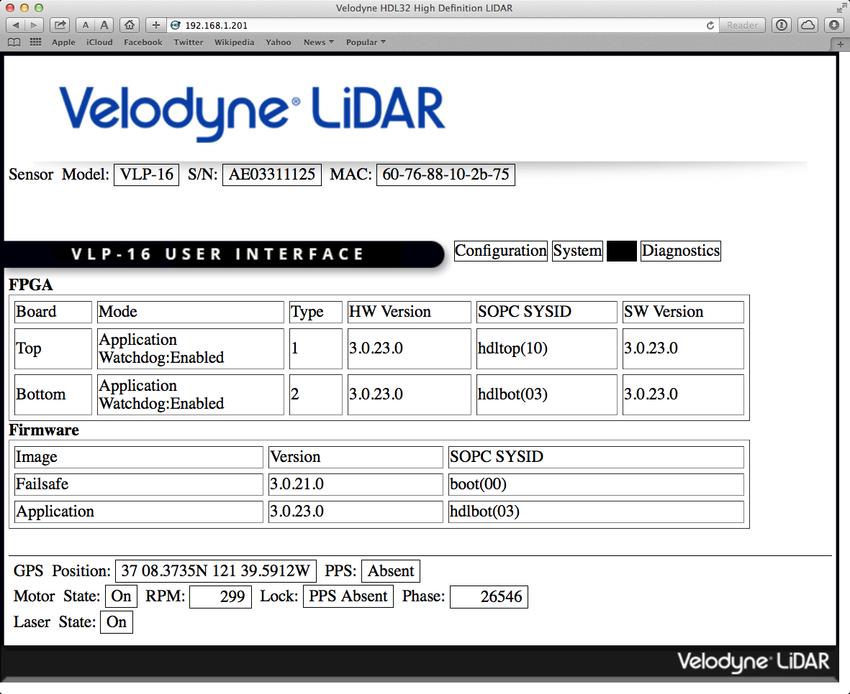
Information Page

Slide 5
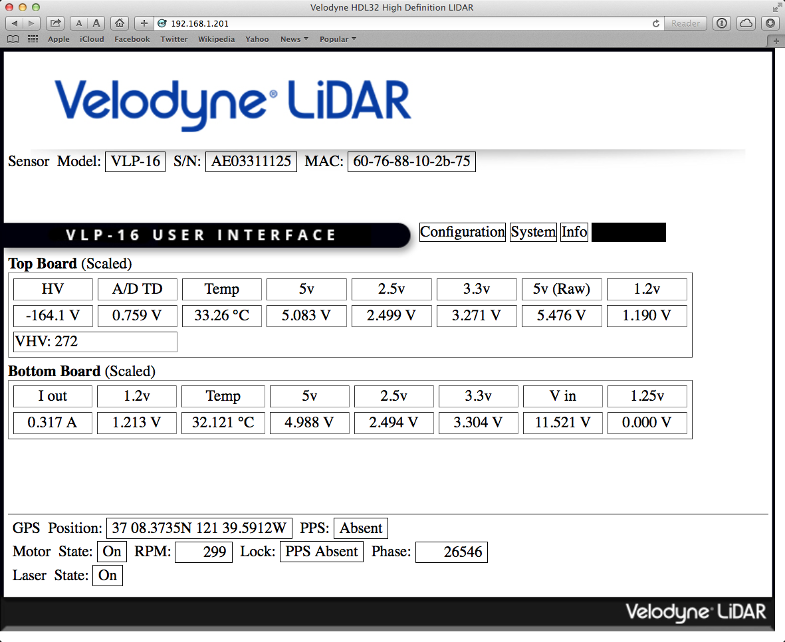
Diagnostics Page

